Slide 1
Quantitative Methodologies: Focusing on Data collection and Statistics
International Institute for Reproductive Loss
Priscilla K. Coleman, ph.d.

Slide 2
Sampling:
Basic definitions
A sample is a finite part of a statistical population whose properties are studied to gain information about population.
A population is a group of individuals persons, objects, or items from which samples are taken for measurement.

Slide 3
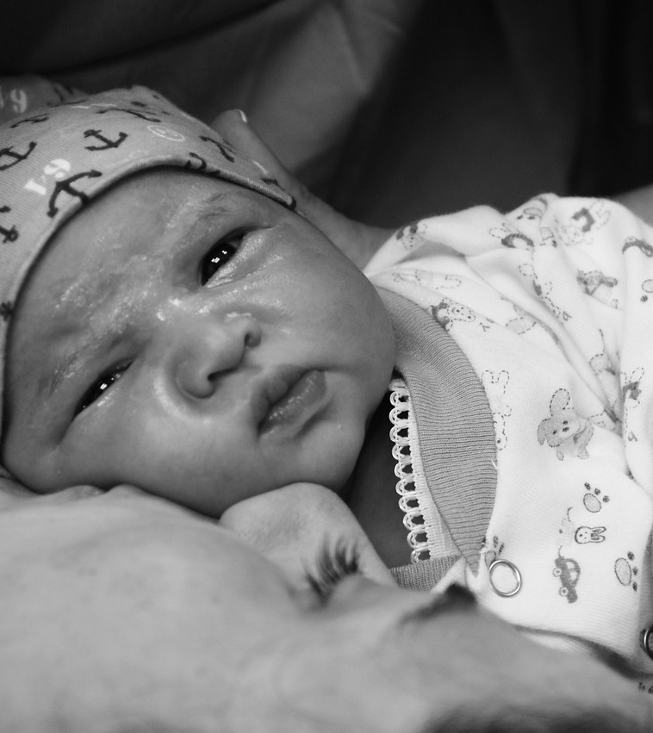
For example, the population of interest might be all women who Gave birth in the U.S. in 2024, and the sample might be every 5th woman who gave birth in each northeastern State in 2024.

Slide 4

Sampling is the act, process, or technique of selecting a representative part of a population for the purpose of determining parameters or characteristics of the whole population.

Slide 5
General information pertaining to sampling
To draw conclusions about populations from samples, we must use inferential statistics.
Inferences about the population are drawn from a sample.
There would be no need for statistical theory if a census rather than a sample was always used to obtain information about populations.
We obtain a sample rather than a complete census of the population for practical reasons – time, expense, size of populations, and accessibility.

Slide 6

Bias And Error in Sampling

Slide 7
Overview and definition of sampling error
Sampling Error is defined as differences between the sample and the population due solely to the individuals, who happen to have been selected. Sampling error can make a sample unrepresentative of its population.
In practice, it is rarely known when a sample is not representative of the population and the results should be discarded.
For example, suppose that in a sample of 100 American women the average height is found to be 5ft 5in. This seems believable given the actual height in 2024 is 5ft 4in. However, if sampling included a disproportionately high number of younger women, there would be error in generalizing to the population of all women as people lose 1 to 3 inches as they age.
A sample is expected to mirror the population from which it comes, however, there is no guarantee that any sample will be precisely representative of the population.
Chance may dictate that a disproportionate number of untypical observations will be made.

Slide 8

Two Sources of Sampling Error
Sampling Bias: The tendency to favor the selection of people who have certain characteristics; usually the result of a poor sampling plan.
The most notable is the bias of non-response when for some reason some units have no chance of appearing in the sample.
  For example, a survey was conducted at Cornell Graduate school to find out the level of stress that graduate students were going through. A mail questionnaire was sent to 100 randomly selected graduate students. Only 52 students responded, and the results reported were that students were not under stress at that time, when in fact it was the highest stress time for all students, except those who were writing their theses at their own pace. Apparently, this is the group that had the time to respond. The researcher who was conducting the study went back to the questionnaire to find out what the problem was and found that all those who had responded were 3rd and 4th year PhD students
Chance: Error may occur just by chance - due to bad luck.
Unusual units in a population do exist and there is always a possibility that an abnormally large number of them will be chosen.

Slide 9
Selecting the sample
Sampling bias can be minimized by the wise choice of a sampling procedure.
Chance obviously can’t be controlled.

Slide 10
Four primary types of samples
1) Convenience Sample: Made up of readily available participants chosen from a population. A non-systematic procedure that precludes generalizing to a larger group.
2) Purposive Sample: The researcher targets a group of people believed to be typical or average, or a group of people specially picked for some unique purpose. The researcher never knows if the sample is representative of the population, and this method is largely limited to exploratory research.

Slide 11
3) Snowball sample (also referred to as a network, chain, or reputational sample). Method begins with a few people and then gradually increases the sample size as new contacts are referred by the initial participants.
4) Random sample: A method that allows for a known probability that each potential participant will be selected. Also referred to as a probability sample. This is the type of sampling that is used in lotteries and raffles.

Slide 12

Types of Random Samples

Slide 13

TYPES OF RANDOM SAMPLES
A simple random sample is secured by choosing units in such a way that each unit in the population has an equal chance of being selected. A simple random sample is free from sampling bias.
A systematic random sample is obtained by selecting the first person on a random basis and choosing additional people at evenly spaced intervals until the desired number of is obtained.

Slide 14

TYPES OF RANDOM SAMPLES
A stratified sample is obtained by independently selecting a separate simple random sample from each population strata (homogeneous groups based on a characteristic or variable such as income or education). Then participants are randomly selected from each strata, with the number selected designed to maintain population proportions in the sample.
Researchers often employ stratified sampling when a population’s characteristics are diverse to accurately represent differences within the population in the target sample.

Slide 15

TYPES Of RANDOM SAMPLES
A cluster sample is obtained by selecting groups (clusters) from the population with simple random sampling. The sample comprises all individual units in each random cluster selected. For example, if a researcher is interested in Protestant church members’ attitudes toward adoption in Texas, a random selection of 50 churches could be selected and then all members within the selected churches (clusters) could be surveyed.
Although very economical, cluster sampling is highly susceptible to sampling bias. A researcher is likely to get similar responses from people in the same cluster based on interaction and/ or share characteristics.

Slide 16
Sample size
In general, sample size depends
on several factors
The nature of the statistical analyses to be performed.
The desired precision of the estimates one wishes
to achieve.
The kind and number of comparisons that will be made.
The number of variables to be examined simultaneously.

Slide 17

Statistical Analysis of Data
Descriptive statistics allow you to summarize a data set; whereas inferential statistics allow you to draw conclusions about a population based on sample data.

Slide 23

Characteristics of Variables necessary FOR choosing the correct statistical Test
In a between-subjects design, also called a between-groups design, participants experience only one condition or level of the Independent variable, and differences between participants in various conditions are compared.
In a within-subjects design, every participant experiences every condition of the independent variable.

Slide 24
Independent and Dependent Variables
Independent variables are variables that are not influenced by other variables in a study. The independent variable can be a “treatment” (such as a medication), a “risk factor” (such as obesity), an intervention (attending Alcoholics Anonymous), or a predictor (such as weight or age).
The independent variable might be a natural or pre-existing difference (such as gender), or it could be varied/manipulated by the researcher intentionally.
Dependent variables are variables impacted by other variables. The dependent variable is sometimes called the “response” or the “outcome” variable. The researcher expects it to change as a function of the independent variable.
This variable is often the main focus of a research study.

Slide 25

Levels of Measurement
Nominal: categorical data.
Ordinal: categorical data that can be ranked.
Interval: categorical, ranked, and evenly spaced data.
Ratio: categorical, ranked, and evenly spaced data with a natural zero.

Slide 27

“In God we trust, all others must bring data.” ‘
- W. E. Deming

